Slide 1
Introduction to FHIR
Grahame Grieve
Oct 29, 2013

Slide 2

An instigator of bad puns
Fast Healthcare Interoperability Resources
FHIR is the hottest thing since . . .
This spec is spreading like . . .
Committee X is really on FHIR
Feel free to come up with your own

Slide 3
Content
Brief Introduction to FHIR
What can you do with FHIR?
What’s in the future?

Slide 4
FHIR Manifesto
Focus on Implementers
Leverage cross-industry web technologies
Target support for common scenarios
Require human readability as base level of interoperability
Support multiple paradigms & architectures
Make content freely available
Demonstrate best practice governance
Notes:
We don’t actually have a formal manifesto, but these are the principles we adhere to.

Slide 5
Web technologies
Instances shared using XML & JSON
Collections represented using ATOM
Same technology that gives you your daily news summary
Out-of-the-box publish/subscribe
Web calls work the same way they do for Facebook & Twitter
Rely on HTTPS, OAuth, etc. for security functions
http://...
Notes:
We try very hard to *not* invent stuff that exists elsewhere unless it’s really broken or totally unaligned with the FHIR principles.

Slide 6
Support “Common” Scenarios
80%
Inclusion of content in core specification is based on core rule
“We only include data elements if we are confident that 80% of implementations maintaining that resource will make use of the element”
Other content pushed to extensions
(more on this later)
Easy to say, governance challenge to achieve
Notes:
Design by constraint failed – years to develop, what was produced required yet more design to be implementable and after that might not be interoperable
How to determine the 80%? Look to existing specs – v2, v3, CDA templates, OpenEHR, jurisdictional projects, what implementations we’ve seen
If not sure, err on the side of “not in for now”
Note: not 80% of instances, 80% of implementations
Challenges with “raising the bar”
What happens when there aren’t many/any implementations?

Slide 7

Human Readable
A very important lesson from CDA
Even if the computers don’t understand 99% of what you’re sending, that’s ok if they can properly render it to a human clinician
This doesn’t just hold for documents – important for messages, services, etc.
In FHIR, every resource is required to have a human-readable expression
Can be direct rendering or human entered
Notes:
Even when you think your target will understand all the encoded data, reality is data often gets shared beyond the originally intended context
Allow for exceptions for things like automated device readings, etc.

Slide 8
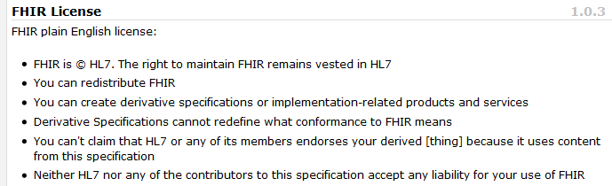
Freely available
Unencumbered – free for use, no membership required
http://hl7.org/fhir
Notes:
Was a bigger deal before HL7 decided to open up all IP
full legal text towards bottom of FHIR home page

Slide 9
Paradigms
FHIR supports 4 interoperability paradigms
REST
Documents
Messages
Services

Slide 10
Paradigms
Regardless of paradigm the content is the same
This means it’s straight-forward to share content across paradigms
E.g. Receive a lab result in a message. Package it in a discharge summary document
It also means constraints can be shared across paradigms
E.g. Define a profile for Blood Pressure and use it on resources in messages, documents, REST and services

Slide 11


Resources
“Resources” are:
Small logically discrete units of exchange
Defined behaviour and meaning
Known identity / location
Smallest unit of transaction
“of interest” to healthcare
V2: Sort of like Segments
V3: Sort of like CMETs

Slide 12
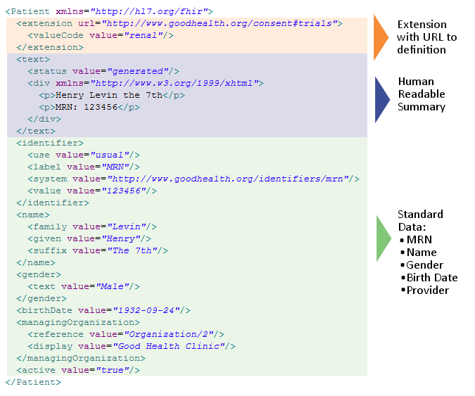
Notes:
System for gender is wrong . . .

Slide 13
It’s all about the resources . . .
Location
Lab
Report
Related
Person
Patient
Practitioner

Slide 14
Manageable Extensibility
Extensions are built into the wire format
All conformant systems can “handle” any possible extension - Just a bucket of “other stuff”
Use modifierExtensions for extensions that “change things”
Require formal definitions of extensions to be available in interoperability space
Extensions rendered in human readable portion

Slide 15
What can you do with FHIR?

Slide 16
What you can do
REST is inherently a platform – a capability
All sorts of collaborations are possible using the base API

Slide 17
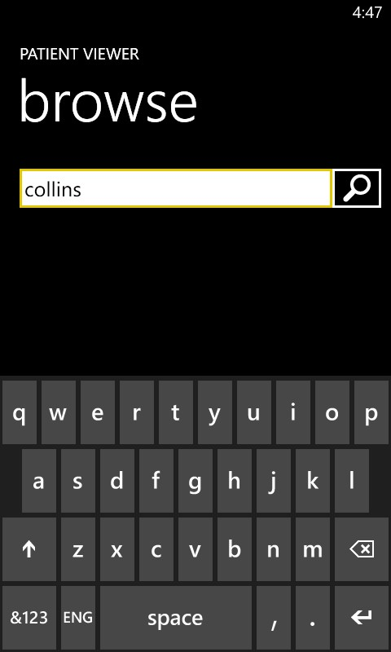
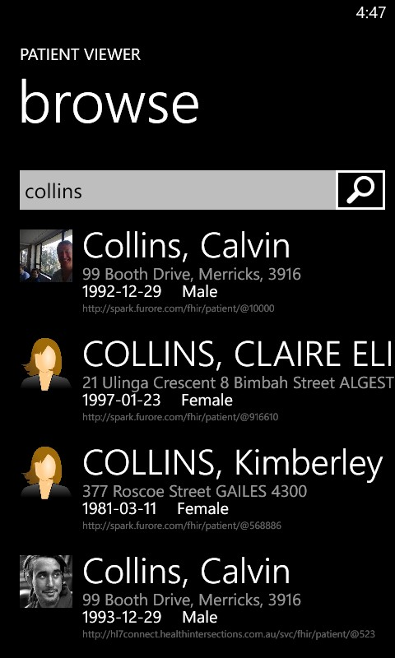

Slide 18
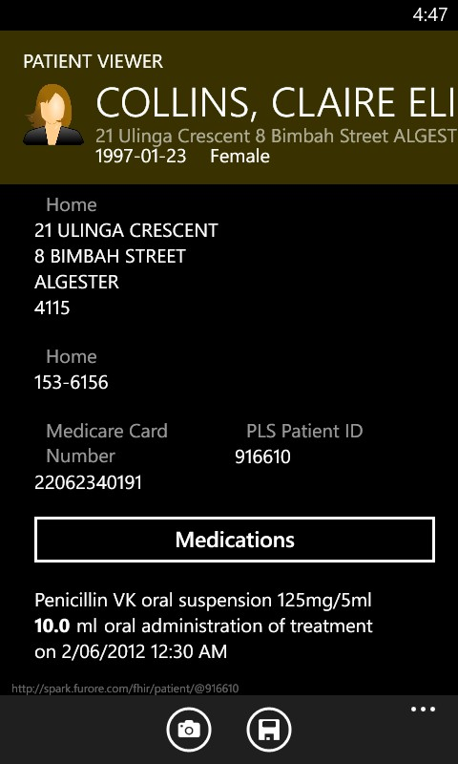
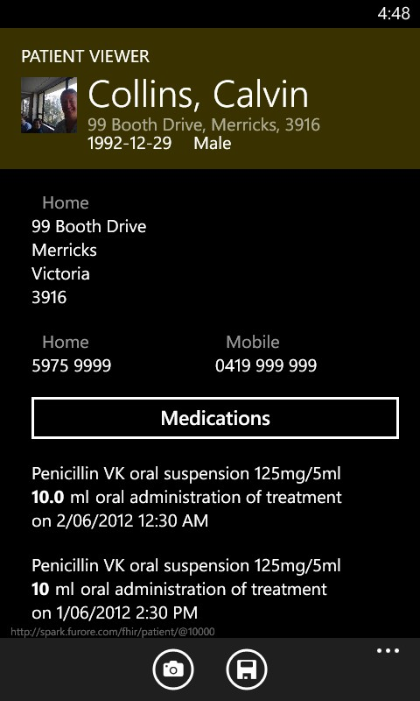

Slide 19
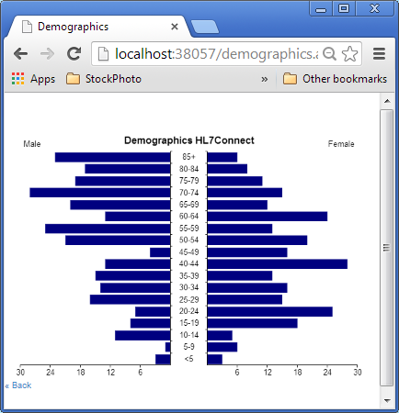
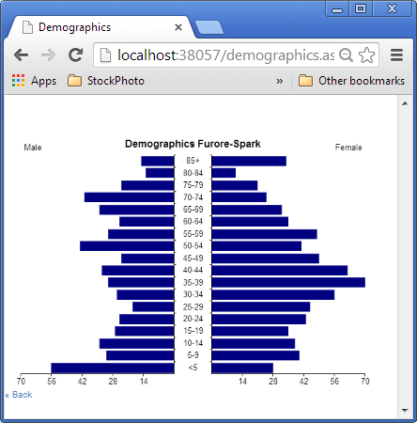
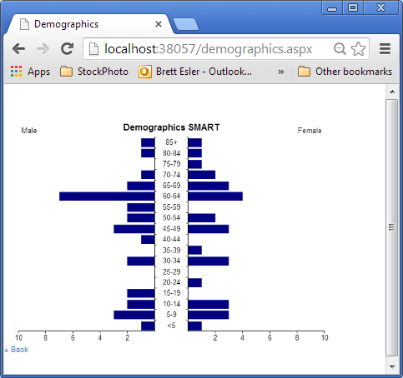
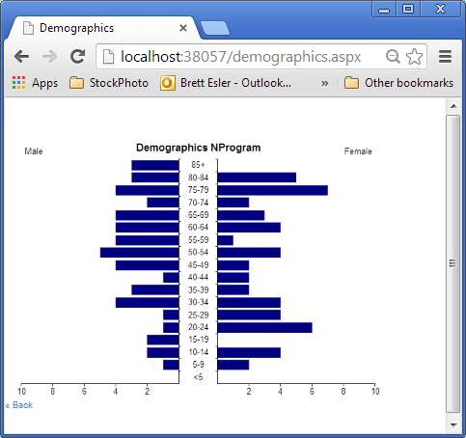
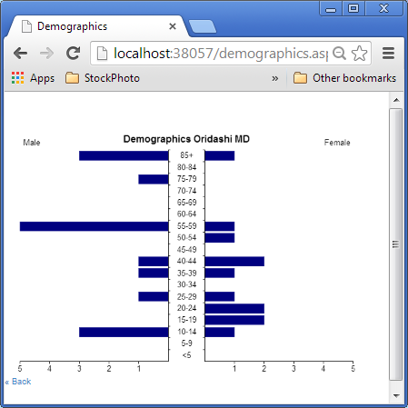
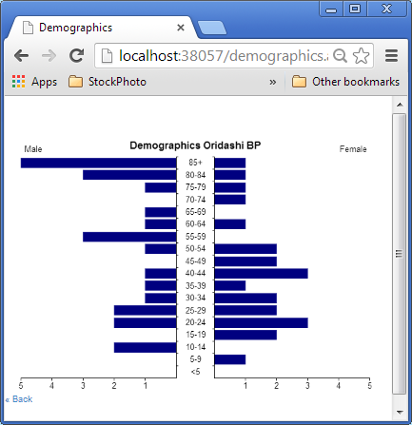
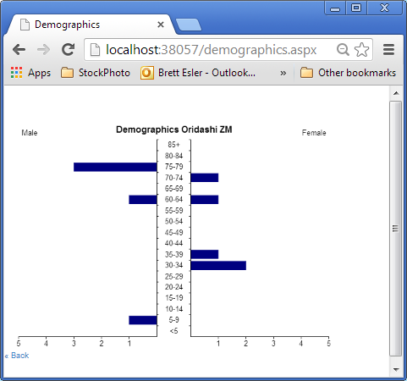
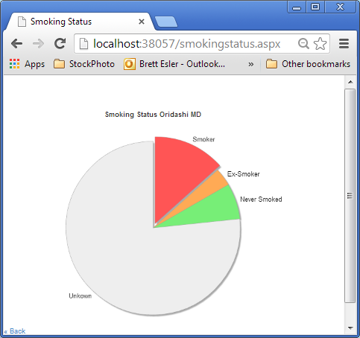
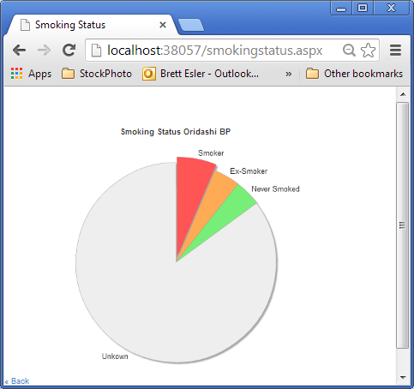
Click and Play Client from Base URL
Australian, Dutch, US and UK servers
3 Australian GP Systems wrapper servers

Slide 20
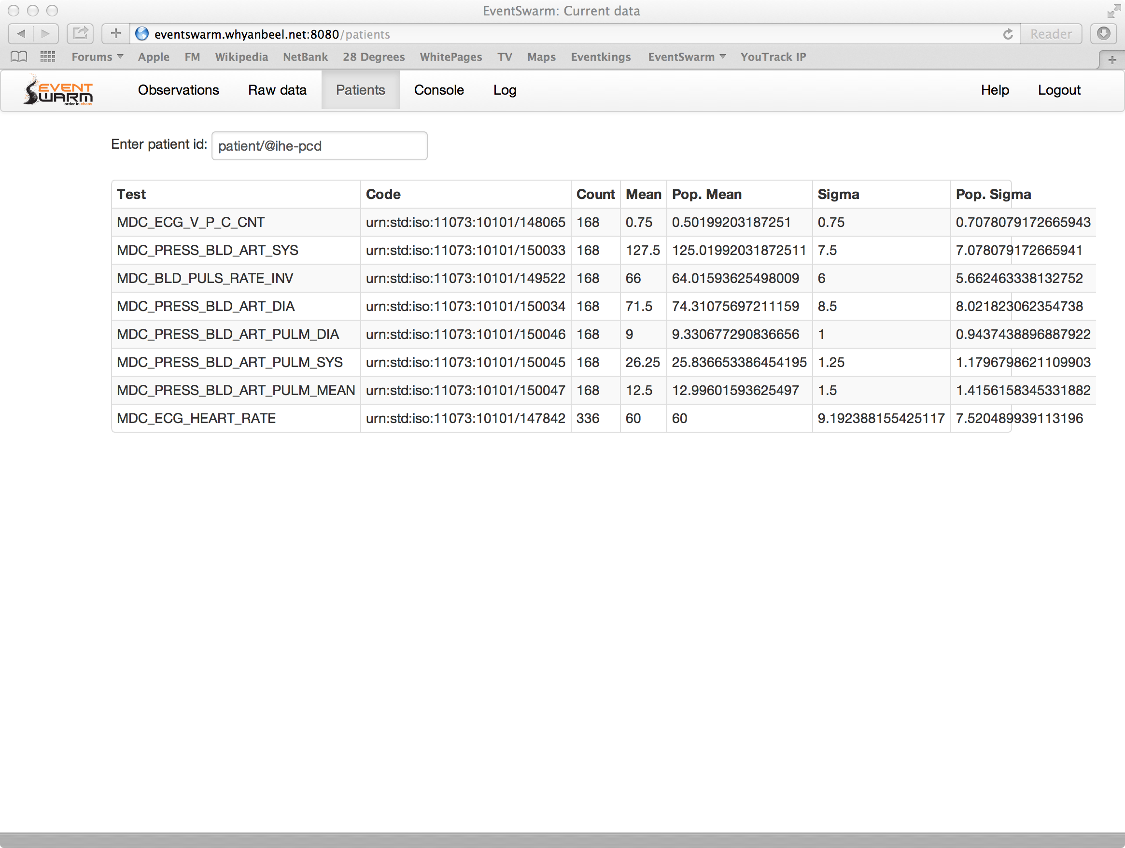

Slide 21
You can do anything…
Which has it’s downside: what do you do?
There’s going to be need for implementation guides to make choices
FHIR is an international platform specification
Will be realm and domain guides

Slide 22
What’s in the future?

Slide 23
Future
Jan 2014 – publish the DSTU
Through 2014:
Implementation & Evangelisation Activities
Add to DSTU (Sept?): Additional resources
Through 2015
More
+ start preparing normative ballot?

Slide 24
Future
Impact of FHIR on the market:
Drive interoperability prices down
Higher Expectations
Increased spend on integration (N x 2!)
Overall Market focus
PHR + SMAC
Healthcare repositories (MHD+)
Device Data management
Retooling existing connections

Slide 25
FHIR & Cost of Integration
FHIR is designed for implementers
Written to be understood and implemented
Resources are described in the language of the problem
Quality and Consistency is in the background
Version Stability inherent
1000s of examples
Implementation assistance (code etc)
Live Servers, Regular Connectathons

Slide 26
FHIR & Cost of Integration
FHIR re-uses technology
Copy Facebook, Google, Twitter etc
Work with W3C
Skills & Libraries are easily available
RESTful API is re-usable
Push / Pull / Subscribe / Search
Build on top of it

Slide 27
FHIR & Cost of Integration
FHIR is free and accessible
No limitations on use or distribution
Published as a website (direct linking)
Tutorials, Documentation published under open licenses

Slide 28
FHIR & Cost of Integration
These factors will drive down the cost of integration and interoperability
Easier to Develop
Easier to Troubleshoot
Easier to Leverage in production
More people to do the work (less expensive consultants)
Competing approaches will have to match the cost, or disappear – effect is already being felt

Slide 29
Future
Impact of FHIR on the market:
Drive interoperability prices down
Higher Expectations
Increased spend on integration (N x 2!)
Overall Market focus
PHR + SMAC
Healthcare repositories (MHD+)
Device Data management
Retooling existing connections

Slide 30
Future Challenges
Still a lot of missing coverage
A lot of clinical content to cover
Leverage CCDA knowledge
Still missing infrastructure
A way to collate & organise content
Additional tooling still needed
Impact on community
New people come to HL7
Governance Problems kicked down the road

Slide 31
FHIR Manifesto
Focus on Implementers
Leverage cross-industry web technologies
Target support for common scenarios
Require human readability as base level of interoperability
Support multiple paradigms & architectures
Make content freely available
Demonstrate best practice governance
Notes:
We don’t actually have a formal manifesto, but these are the principles we adhere to.

Slide 32
FHIR
http://hl7.org/fhir
Twitter: #FHIR
Notes:
We don’t actually have a formal manifesto, but these are the principles we adhere to.

